Slide 1
Using Spectral Methods and the Quasilinearization Method (QLM) to Solve Non-Linear ODEs
By Maximus Smith
Notes:
Welcome to this talk Spectral Methods and the Quasilinearization Method to solve Non-Linear ODEs. We will in future refer to Quasilinearization as QLM.

Slide 2

Spectral Methods Overview
Assume a solution of an Ordinary Differential Equation (ODE):
$y_{N}=\sum_{k=0}^{N}{a_{k}φ_{k}(x)}$ [1]
Goal: Find $a_{k}$ by forcing our solution to satisfy the ODE at certain points.
(Collocation points)
We can make better solutions by using different basis functions ($φ_{k}(x)$)
(e.g. Chebyshev Polynomials)
Notes:
Assume solution. Force it to satisfy ODE at particular points (collocation points) forcing it just means put the solution into the ODE and for each point make the LHS = RHS. This results in linear equations. Using different basis functions leads to better solutions but we won’t look at the what and why’s of the choice of basis functions today.

Slide 3
The Problem with Spectral Methods
Linear ODEs result in Linear Equations
- Easy to solve
Non-Linear ODEs result in Non-Linear Equations
- Very hard to solve
Notes:
When solving linear odes we get linear equations, easy to solve. When solving Non-Linear ODEs we get Non-Linear equations which aren’t easy to solve.

Slide 4
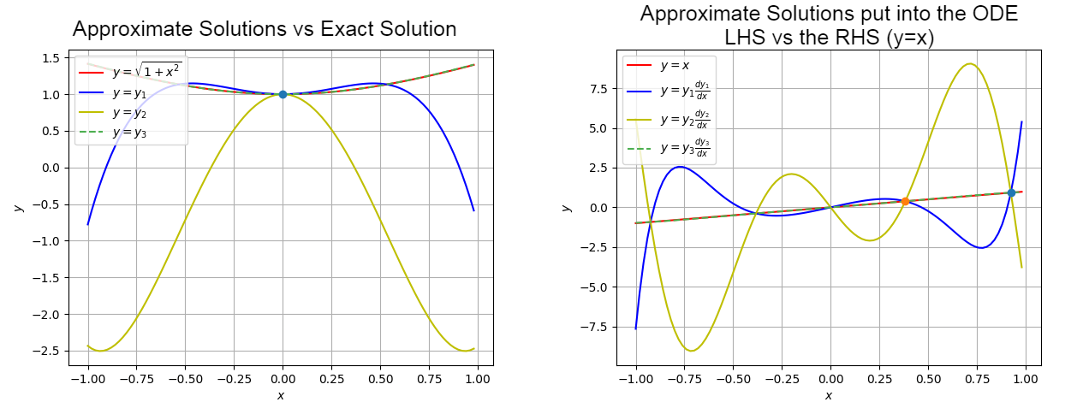

Example of Aliasing when solving: $y\frac{dy}{dx}=x$ and $y\left(0\right)=1$
Figure 1: (Left) Shows 3 approximate solutions. (Right) Shows those solutions put into the ODE. Both cases the red line is the exact solution. The points marked on are the boundary conditions (left) and collocation points (right) respectively.

Slide 5
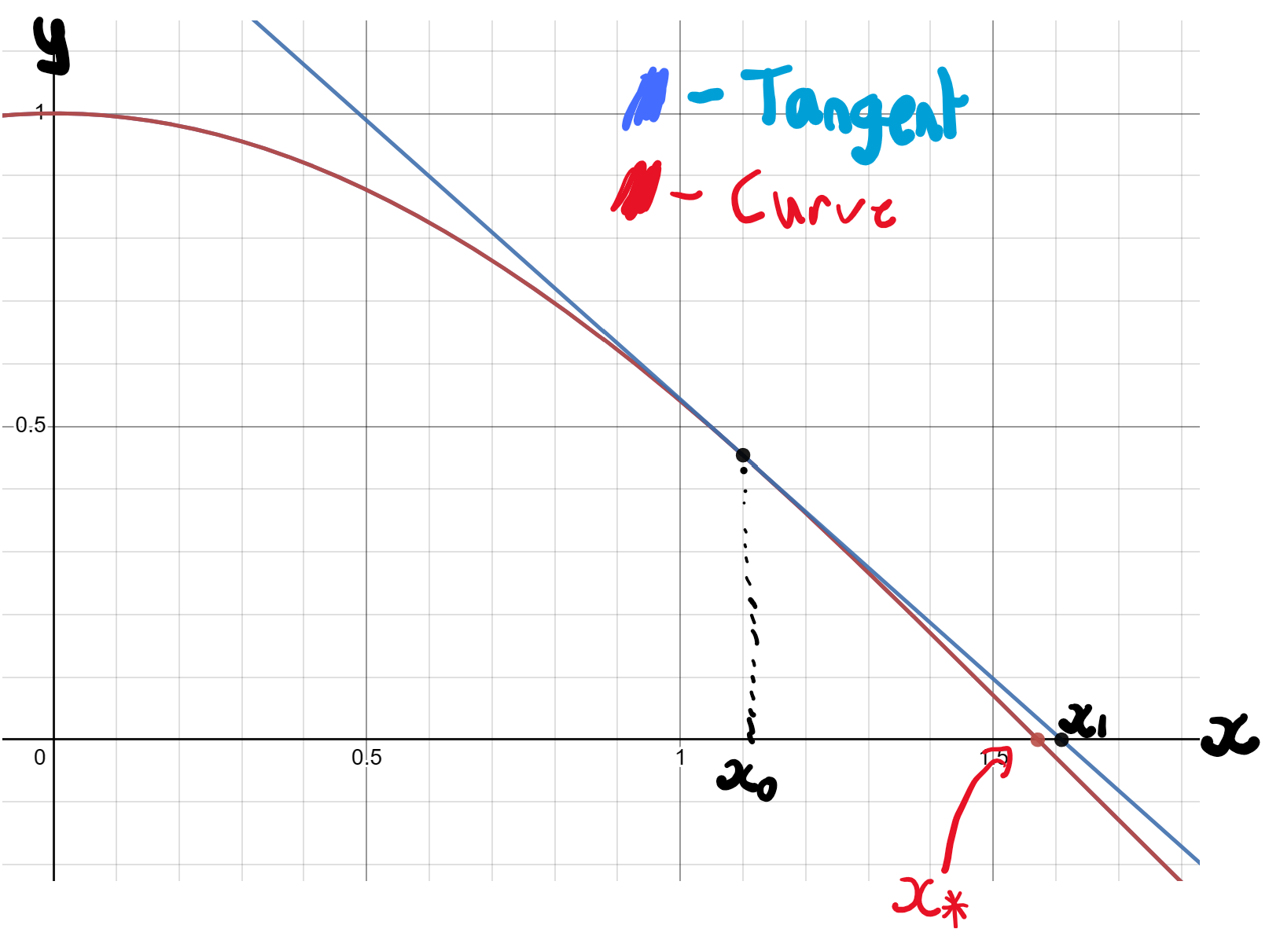

How can we do this on a Non-Linear ODE? Quasilinearization Method (QLM)
Rewrite ODE as $L(y(x))=f\left(y\left(x\right)\right)$ with:
L – Linear, f – Non-Linear [2]
Decide a reasonably good solution $y_{i}(x)$
Find a $1^{st}$ order Functional Taylor Series of $f(y(x))$about the point $y_{i}(x)$
Solving the resulting ODE leads to $y_{i+1}(x)$
Figure 2: Sketch of the Newton-Raphson Method
Notes:
Instead we try to convert our Non-Linear ODE into the most similar Linear ODE. We start by guessing a good solution. Approximate the Non-Linear using a first order functional taylor series ie. A tangent to the differential equation. Solving the resulting ODE leads to a solution we call yi+1 that should be closer to the exact solution. Repeat and we should get convergence to a very accurate solution. This is the same idea behind the Newton-Raphson method and below you can see a graphical illustration of what we are doing except we are in functional space.

Slide 6

Functional Taylor Series
Same as multivariate taylor series except our “variables” are: $y\left(x\right),y^{′}\left(x\right),y^{′′} \left(x\right)…$ ext.
Example – Expand to first order about $y_{i}(x)$: $\cos\left(y(x)\right)y′(x)$
$⇒$ $\cos\left(y_{i}\left(x\right)\right)y_{i}′\left(x\right)+[ −sin⁡(y_{i}\left(x\right){)y}_{i}′\left(x\right)](y\left(x\right)−$ $y_{i}\left(x\right))+[\cos\left(y_{i}\left(x\right)\right)](y^{′}\left(x\right)−y_{i}′\left(x\right))$
Remark: Multivariate Taylor Series -
$$f\left(x,y\right)=f\left(x_{i},y_{i}\right)+\frac{∂f\left(x_{i},y_{i}\right)}{∂x}\left(x−x_{i}\right)+\frac{∂f\left(x_{i},y_{i}\right)}{∂y}\left(y−y_{i}\right)$$
Notes:
Finding a functional taylor series. In this example we are expanding cos(y(x))(y’(x)) to first order about yi(x). To do this we treat it like a multivariate taylor series except our variables are y(x),y’(x),y’’(x) ext. I’ve matched it up colourwise below with a multivariate taylor series

Slide 7

Practical Example: Lane-Emden Equation
$y^{′′}+\frac{2}{x}y^{′}+y^{n}=0 y\left(0\right)=1 and { y}^{′}\left(0\right)=0$ [2]
1) $y^{′′}+\frac{2}{x}y^{′}={−y}^{n}$
2) $y^{′′}+\frac{2}{x}y^{′}={{(−y_{i}}^{n})+(−ny_{i}}^{n−1}$)($y−y_{i})$
$⇒{(y_{i+1}}^{′′})+\frac{2}{x}{{(y}_{i+1}}^{′})+{ny_{i}}^{n−1}{(y}_{i+1})=(n−1)$ ${y_{i}}^{n}$
Notes:
Here’s a practical example on solving a historically tricky Non-Linear ODE. First we split into a linear and non-linear part. Then we find the functional taylor series of the non-linear part. Finally we rearrange into a nice form and you can see this is a Linear ODE in yi+1. Then we choose a suitable y0.

Slide 8


How to choose the starting point $(y_{0})$
General case
For convergence: $y_{0}$ must satisfy the boundary conditions.
For optimal convergence: $y_{0}$ must match as many functional characteristics as the exact solution as possible.
Lane-Emden $n≥2$
For convergence: ${ y}_{0}\left(0\right)=1 and{ y}_{0}′\left(0\right)=0$
For optimal convergence: Require$\lim_{x→∞}{y_{0}(x)}=0$

Slide 9
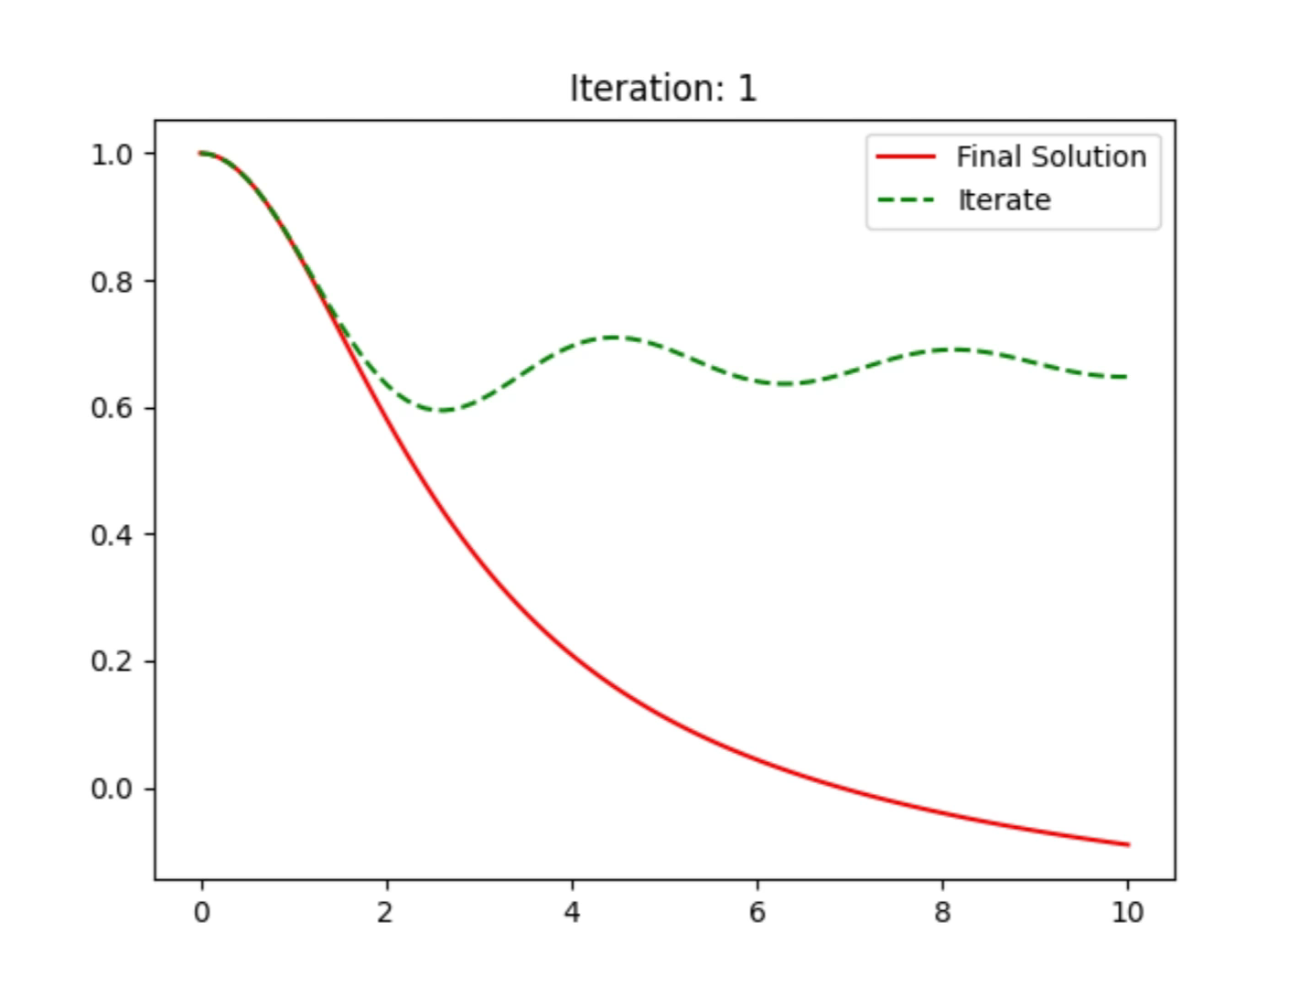

Using Chebyshev Polynomials (Lane-Emden n=3)
y
x
Figure 3: Shows iterates of the QLM (green), converging to the converged solution (red),
with $y_{0}=1$.
Notes:
Here’s the result using the Chebyshev basis, for this ive picked y0 to just be 1 as it satisfies the boundary conditions. The green lines which are the iterates converge very fast to our exact solution in red. But in this example we are limited in domain width, anything wider than [0,13] and we get rapid blow up of the QLM.

Slide 10
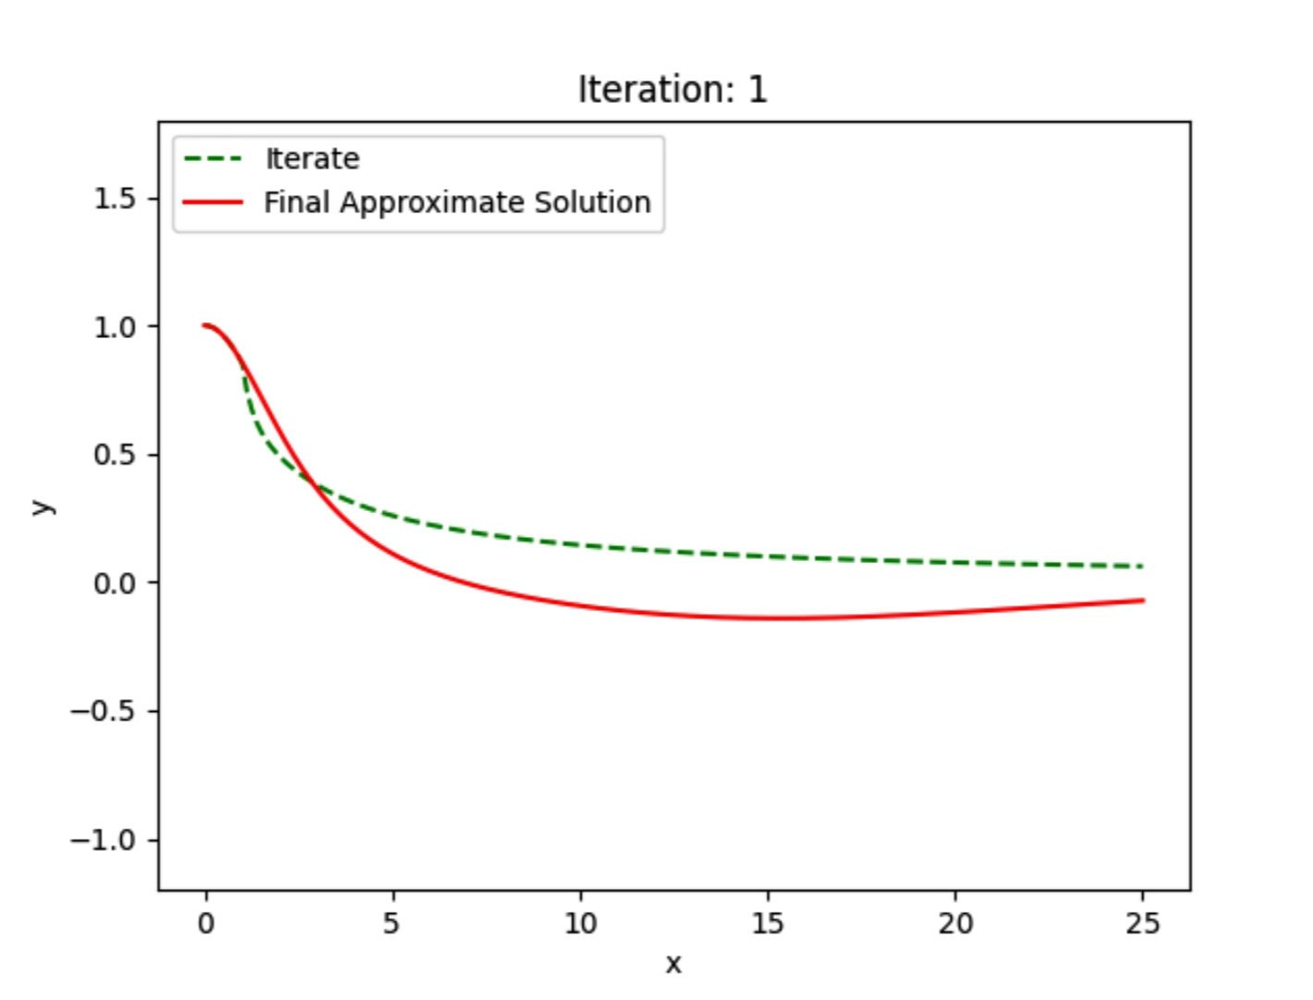

Using Rational Chebyshev Functions (Lane-Emden n=3)
Figure 4: Shows iterates of the QLM (green), converging to the converged solution (red).
In this case: $\lim_{x→∞}{y_{0}=0}$ and $y_{0}$satisfies the boundary conditions.
Notes:
In this example likewise we get very fast convergence but on a much wider domain. This is because we can make the initial solution satisfy the boundary conditions and tend towards 0 like the exact solution is predicted to. Nevertheless this method is still bounded on [0,25]

Slide 11
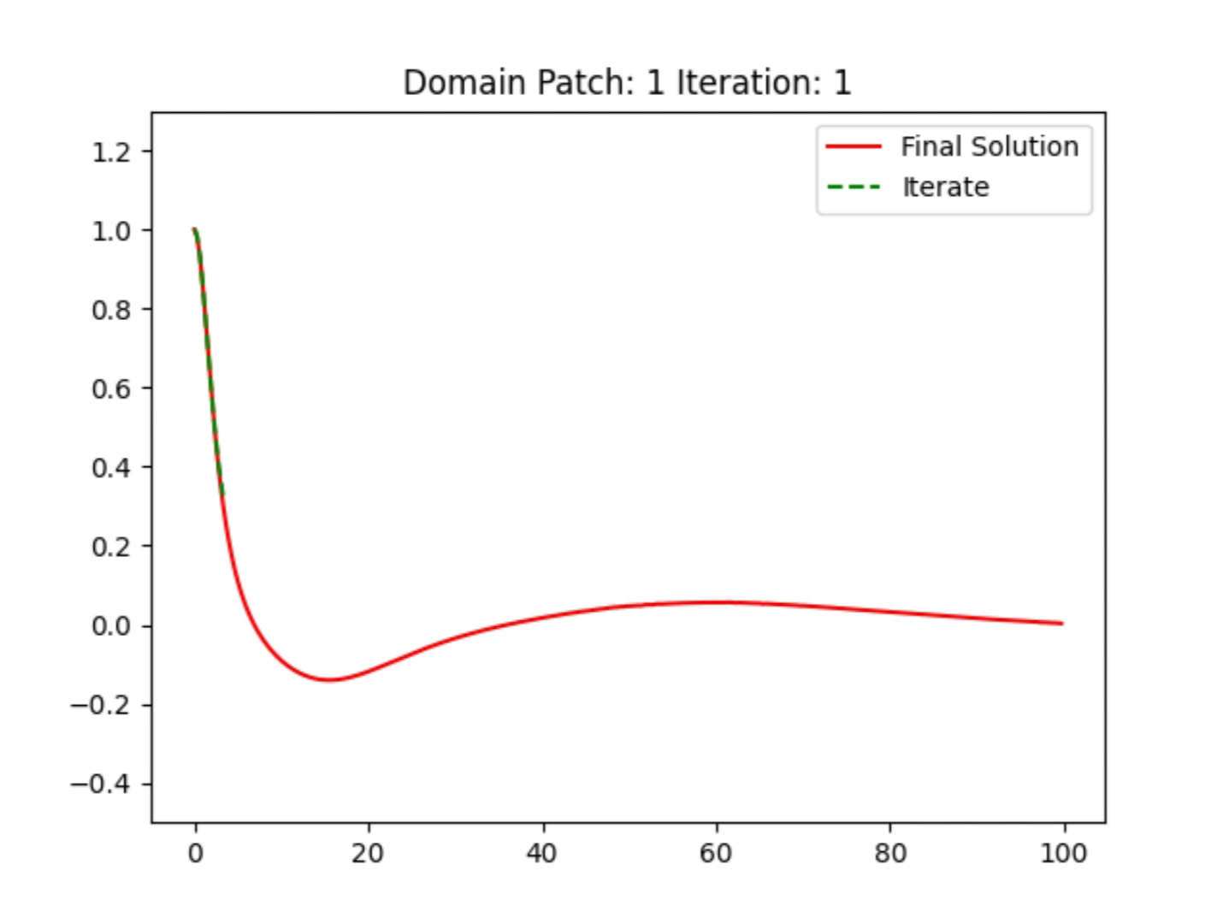
Using Domain Patching and Rational Chebyshev Basis (Lane-Emden n=3)
y
x
Figure 5: Shows iterates of the QLM (green), converging to the converged solution (red). In this case we split the domain into subdomains and solve on each subdomain. The boundary conditions come from forcing the overall solution to be continuously differentiable across each boundary.
Notes:
Finally I used the same method as before but then using Domain Patching as well, this is where you split the interval, find a solution on the first interval, then find a solution on the second interval and the boundary conditions just force the 2 solutions to be continuously differentiable across the change. This method in theory should have unlimited domain width as you can just make the subdomains smaller while adding more subdomains but this comes at the cost of computing power.

Slide 12
Pros and Cons of QLM
Pros:
- Quadratic Convergence for most cases [2][4]
- We have a method to pick our starting point
- Easy to implement
Cons:
- Resulting Linear ODEs can be hard to solve to high precision
- Can be very unstable
- Currently unknown specifically when the QLM converges

Slide 13
Future Research -------------- Concluding Remarks
Collect a full set of conditions for convergence of the QLM
Find an efficient method for solving Non-Linear ODEs with the QLM on large domains

Slide 14

Any Questions?
References:
[1]J.P Boyd Chebyshev and Fourier Spectral Methods Heidelberg 1989 ISBN 0-387-51487-2 S
[2]Mandelzweig VB, Tabakin F (2001) Quasilinearization approach to nonlinear problems in physics with application to nonlinear ODEs. Comput Phys Commun 141:268–281
[3] Zwillinger, D. Handbook of Differential Equations, 3rd ed. Boston, MA: Academic Press, pp. 124 and 126, 1997.
[4] R. Bellman, R. Kalaba, Quasilinearization and Nonlinear Boundary-Value Problems, Elsevier, New York, 1965.
Try my code: (QR Code for Github)

